Slide 1
Why do historians classify ancient Sumer as a civilization?
Chapter 5

Slide 2
Civilization is a society that has developed arts and sciences and organizations.
Until 150 Years ago, Archeologist had no idea that Sumerian People had lived at all.
Mid-19th century archeologist began finding artifacts in the area of the Fertile Crescent (Mesopotamia)
Scientist uncovered: Tablets, pottery and the ruins of the city. They found written language that they had never seen before
By studying they have been able to find out a lot about Sumer

Slide 3
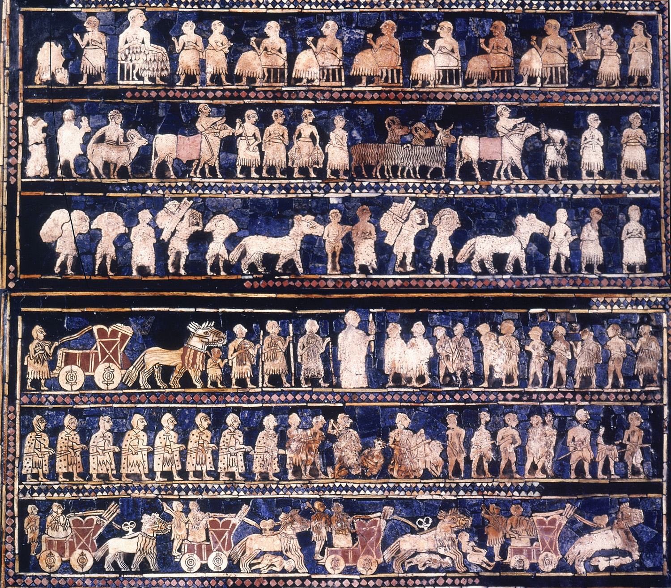
Standard of Ur
Made of wood and decorated with pieces of shell and lapis lazuli (semiprecious blue stone)
Shows Sumerians in times of peace and war
Shows Sumerians had a complex society
Inventions: Plow and writing (are still used today)

Slide 4
Characteristics of Civilization (5.2)
Sumer was a challenging place to live:
Hot summers, little rain, and rivers that flooded in the spring
Built complex irrigation systems and large cities.
By 3000 B.C.E. most Sumerians lived in powerful city-states: Ur, Lagash (LAY-gash), Uruk (Uh-Ruhk)

Slide 5
What makes a civilization?

Slide 6
1. A Stable Food Supply
Ensures that people have enough food
Sumerians invented two key things to help them create stable food supply
Complex Irrigation System
Plow

Slide 7
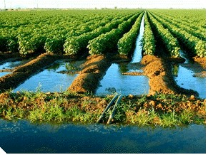
1. Invention of the complex irrigation
Irrigation system that provided their crops with regular water supply
  Canals
  Dams
  Reservoirs

Slide 8
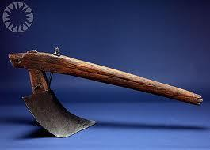
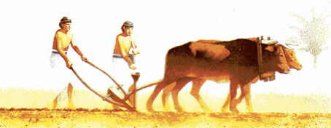
Invention of the plow
Plow- Tool used for tilling or turning the soil to prepare it for planting.
Before the plow farmers would use animal horns or sticks to poke holes in the ground and plant seeds. This process was very slow.
Sumerians invented the plow out of wood. One end was bent for cutting into the ground. The Sumerians pushed and pulled the plow along the ground, or used oxen to pull it.

Slide 9
2. Social Structure (5.4) – Different social levels and jobs
Several classes lived in Sumer
Priest, Landowners and government officials
Lived in large homes & lived near the center of the city
Merchants(sold goods) and Artisans(craftsperson-metal workers)
Worked with gold, silver, tin, lead, copper and bronze. Made swords and arrowheads for army. Plows and hoes for famers. Mirrors and jewelry for upper class(luxury items)
Slaves
Lived in their owners homes and had no property
Farmers and Fishers
Lived in small mud-brick houses at the edge of the city
Worked to build or repair irrigation system and were forced to serve in army during times of war

Slide 10
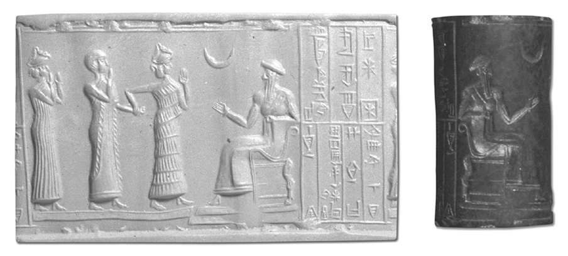
3. System of Government (5.5)
Ensures that life in the society is orderly by directing people’s behavior
Ruled by Kings
Believed that their gods chose kings (very powerful)
Reinforced social order- because obeying the will of the gods were the Sumerians’ strongest belief

Slide 11
Sumerian Kings
1.Enforced laws
2. Collected taxes
3. Built temples
4. Made sure irrigation system was maintained
5. Led his city-states army(one of the most important job because the constant fighting over land boundaries and water use) a. Armies included professional soldiers and temporary citizen-soldiers b. Foot soldiers and others drove chariots with horses
6. Appointed officials to help with duties a. Governors ruled outlying towns b. Scribes helped record laws
*Sumerians were the first to develop a system of written laws

Slide 12
4. Religious System (5.6)
Involves both a set of beliefs and forms of worship
All civilizations have some kind of religious belief
Religious System
Form of Worship
Set of Beliefs in a god or gods

Slide 13
Religious beliefs influenced every part of daily life
Sumerians tried to please their gods in all things
In growing crops
Settling disputes
Religion bound the people together in a common way of life

Slide 14
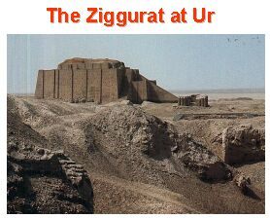
Sumerians expressed their religious beliefs by constructing temples and religious temples called Ziggurats

Slide 15
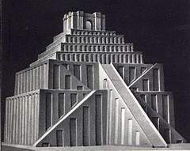
Kings duty to build and maintain
Towers were platforms made of mud bricks
Wood shrines on the highest tier
Were large and could be seen from 20 miles away
Some were as high as 8 stories and as wide as 200 ft
Ziggurat

Slide 16
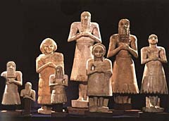
Sumerian Beliefs
Sumerians believed their gods lived in the ziggurats(most likely in the shrines up top)
On the outside walls of the ziggurats were long staircases that the gods could use to climb down to earth
Kings and Priest stood inside the towers to ask for the gods blessings
Sumerian statues also expressed religious beliefs
detailed & lifelike
Many showed people worshipping the gods(eyes gazing upward)
Believed the gods were pleased when people showed signs of devotion, love & obedience

Slide 17
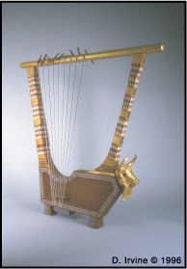
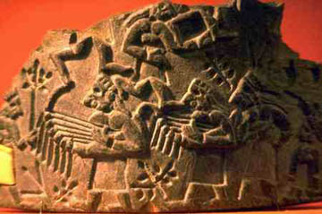
Ceremonies
Musicians played
Human sacrifices
(ritual killing of a person as an offering to the gods)
Lyres- wooden instruments made of a sound box and string. A wooden bar on top held the strings in place
Lyres were decorated with precious stones and with carvings made of horn
This showed the value of music

Slide 18
5. Highly developed way of life : The Arts (5.7)
Art, architecture, paintings, music and literature

Slide 19
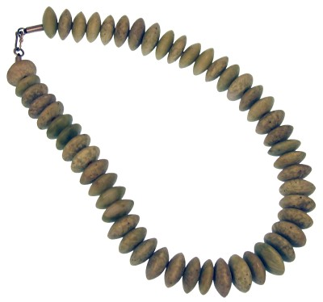
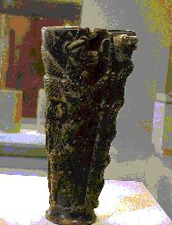
Artist and Artisans in ancient Sumer
Many types of artist and artisans in ancient Sumer
Metalworkers: weapons & cups, jewelry and mirrors (Decorative items)
Architects designed temples and ziggurats

Slide 20
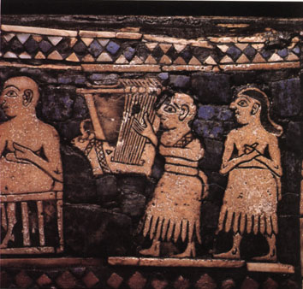
Music
Brought joy to the gods and people
Musicians sang and played music during temple
Wrote love songs
Entertained guest for feast
Instruments included:
drum, pipe & lyre

Slide 21
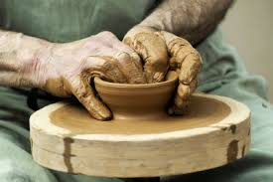
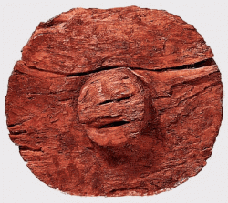
6. Advances in Technology
Sumerians made several technological advances
Most important was the Wheel
Earliest example date back to 3500 B.C.E
Wheel was first used as a surface to shape clay into pots
Potters wheels laid flat and spun on an axle
Sumerian realized that if the wheel was flipped on its edge it could easily roll forward
Discovery was used to make wheeled cart for farmers and chariots for the army
Wheels were built by clamping several pieces of wood together

Slide 22
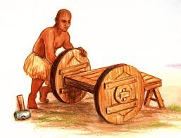
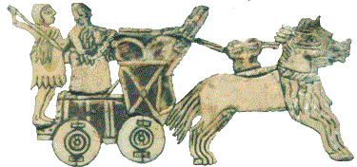
Before the wheel people drug items on sledges (flat bottom carts)
  Get stuck in the mud
  Couldn’t support heavy weight
Wheeled carts made it easier to travel long distance
Oxen could pull three times as much then when using a sledge

Slide 23
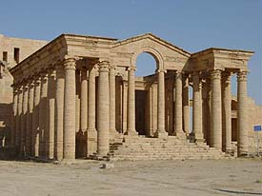
The Arch
Sumerian arches were inverted (upside down) U or V shaped structures built above doorways
To build an arch Sumerians stacked brick made of clay and straw to rise from the walls in steps until they met in the center
Arches added strength and beauty to Sumerian building
Became a common feature of temple entrances and upper class homes
Some historians believe that the arch is the Sumerians’ greatest architectural achievement.

Slide 24
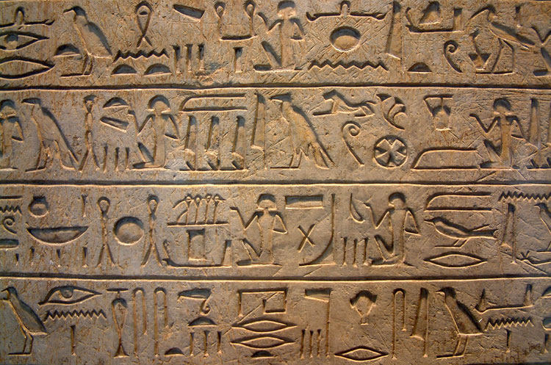
7. Highly developed written language
Cuneiform
Latin word for “Wedge”
Sumerians used a wedge shaped stylus (a sharp, pointed tool) to etch their writing in clay tablets
Cuneiform was developed around 2400 B.C.E.

Slide 25
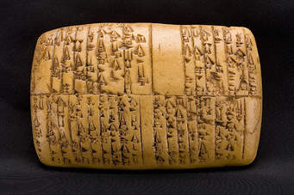
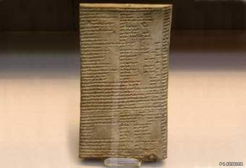
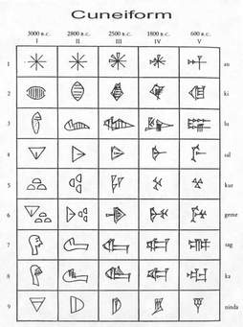
The earliest examples show that it was used to record information about goods people exchanged
Cuneiform may have contained as many as 2,000 symbols to stand for ideas and sounds
Over time the number was reduced to 700
Cuneiform was based off of an earlier simpler form of writing that used pictographs
Pictographs- symbols that stand for real objects (ex. Snake or water)
Scribes used sharpened reed to draw the symbols on wet clay
When dried it became a permanent record

